Slide 1
P-N JUNCTION DIODE
A diode is a two-terminal electronic device consisting of a single p-n junction. This p-njunction is usually created on a single block of silicon by doping the block with donor andacceptor dopants at opposite ends.
A diode is a rectifier, allowing current to pass in one direction but not in the opposite direction.
Dr. S. RANJITH / Physics, SRM IST

Slide 2
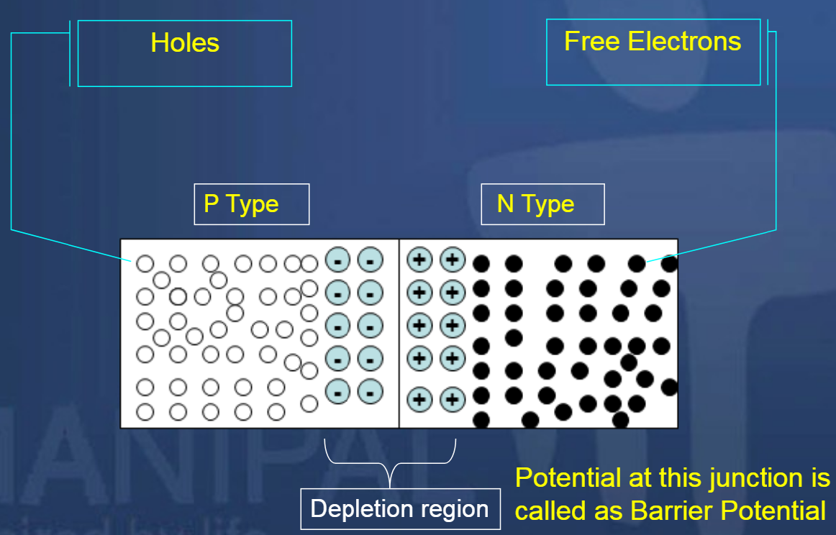
Dr. S. RANJITH / Physics, SRM IST

Slide 3
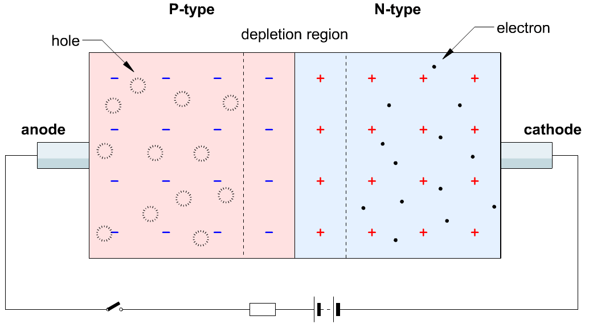
Dr. S. RANJITH / Physics, SRM IST

Slide 4
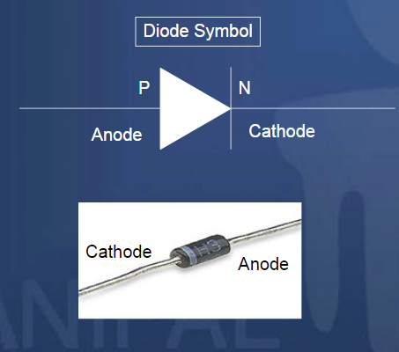
The combination of Electrons and holesdepletes the holes in the P region andelectrons in the N region near the junction
Dr. S. RANJITH / Physics, SRM IST

Slide 5
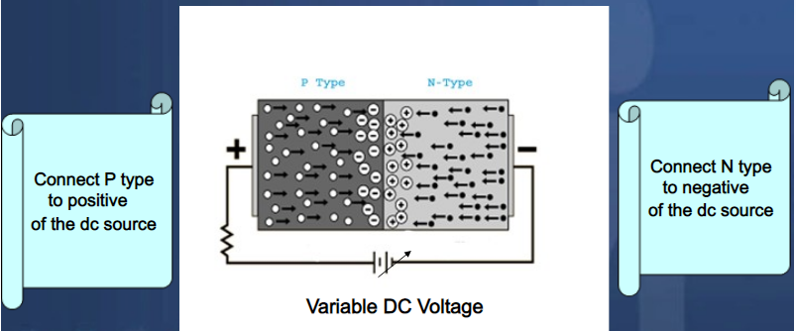
Forward Biasing of PN – Junction Diode
Dr. S. RANJITH / Physics, SRM IST

Slide 6
Forward Biasing of PN – Junction Diode
Forward biasing the p-n junction drives holes to the junction from the p-type material and electrons to the junction from the n-type material.
At the junction the electrons and holes combine so that a continuous current can be maintained.
Dr. S. RANJITH / Physics, SRM IST

Slide 7
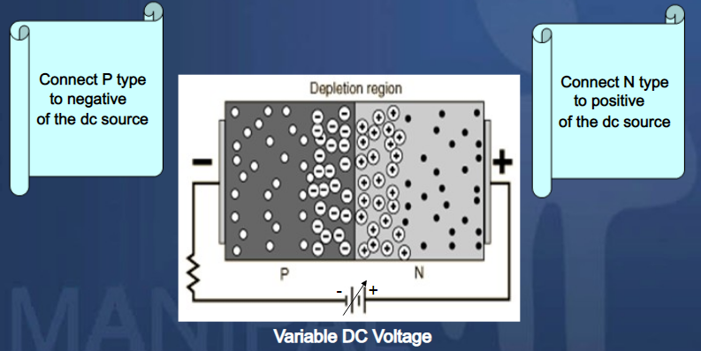
Reverse Biasing of PN – Junction Diode
Dr. S. RANJITH / Physics, SRM IST

Slide 8
Reverse Biasing of PN – Junction Diode
The application of a reverse voltage to the p-n junction will cause a transient current to flow as both electrons and holes are pulled away from the junction.
When the potential formed by the widened depletion layer equals the applied voltage, the current will cease except for the small thermal current.
Dr. S. RANJITH / Physics, SRM IST

Slide 9
Diode is unidirectional, i.e. current flows in only one direction (anode to cathode internally). When a forward voltage is applied, the diode conducts; and when a reverse voltage is applied, there is no conduction.
Dr. S. RANJITH / Physics, SRM IST

Slide 10
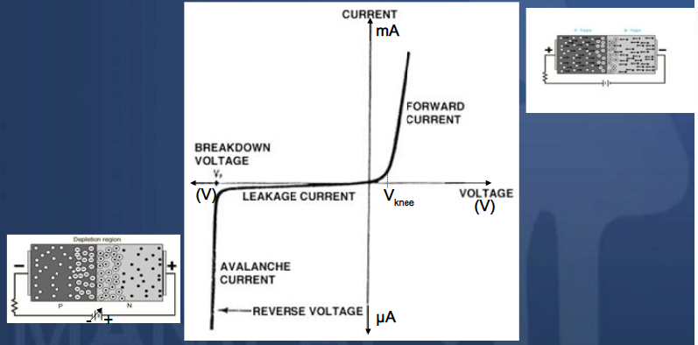
VI Characteristics of PN Junction Diode
Dr. S. RANJITH / Physics, SRM IST

